Slide 1

P351-(nlp-Resume Classification)
Group - II Members:
K Mohammad
MR.S.MADESHWARAN
MR.S.NITHISH
Tumma Shivkumar Ashokrao
Ms. ANJALI AWADHESH PAL
Ms. Arati Shankar Padwal
Mr.K. Mohammed Kaif

Slide 2
Project 351– Resume Classification Business objective- The document classification solution should significantly reduce the manual human effort in the HRM. It should achieve a higher level of accuracy and automation with minimal human intervention

Slide 3
PROJECT ARCHITECTURE
Collection of Data
Business Understanding
Exploratory Data Analysis(EDA)
Deployment
Model Building

Slide 4
Agenda
Brief overview of the topics to be covered.
I - Data Set Details
Abstract
Text Extraction from resumes
II - Exploratory Data Analysis (EDA)
Data Visualization
III - Model Building
Model Evaluation
IV - Model Deployment
V - Conclusion

Slide 5
I . Dataset Details
Abstract
Text Extraction from resumes

Slide 6
ABSTRACT
A resume is a brief summary of your skills and experience. Companies recruiters and HR teams have a tough time scanning thousands of qualified resumes.
Spending too many labor hours segregating candidates resume's manually is a waste of a company's time, money, and productivity. Recruiters, therefore, use resume classification in order to streamline the resume and applicant screening process.
NLP technology allows recruiters to electronically gather, store, and organize large quantities of resumes. Once acquired, the resume data can be easily searched through and analyzed.
Resumes are an ideal example of unstructured data. Since there is no widely accepted resume layout, each resume may have its own style of formatting, different text blocks and different category titles.
Building a resume classification and gathering text from it is no easy task as there are so many kinds of layouts of resumes that you could imagine.

Slide 7
Text Extraction from resumes
Objective: Automate HRM processes, minimize manual effort, and enhance accuracy.
Steps:
Import necessary libraries (spaCy, texteact).
Extract text from different categories (PeopleSoft, React JS Developer, SQL Developer, Workday resumes).
Create a consolidated Dataframe for further analysis.

Slide 8
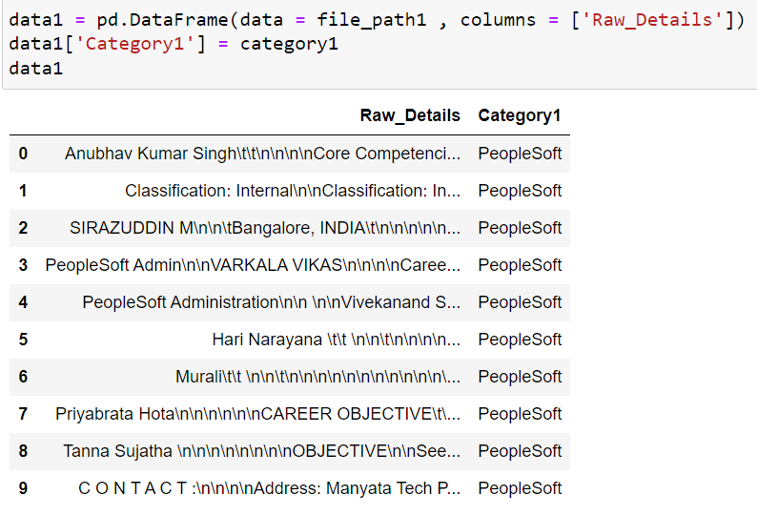
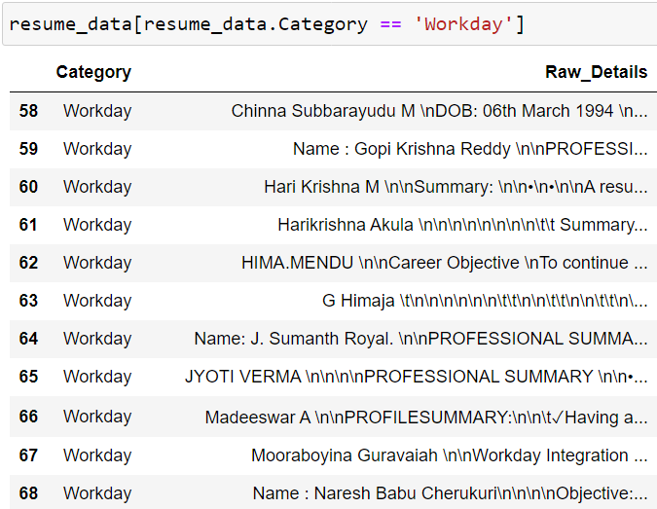
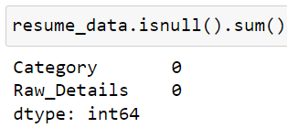

Slide 9
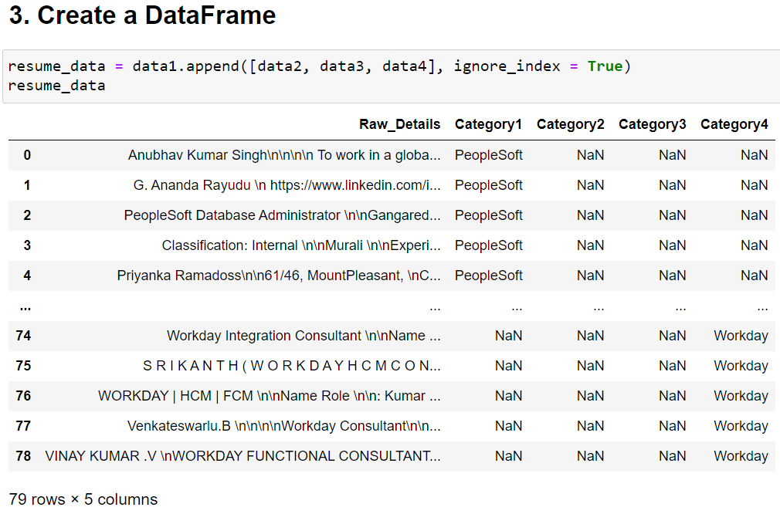

Slide 10
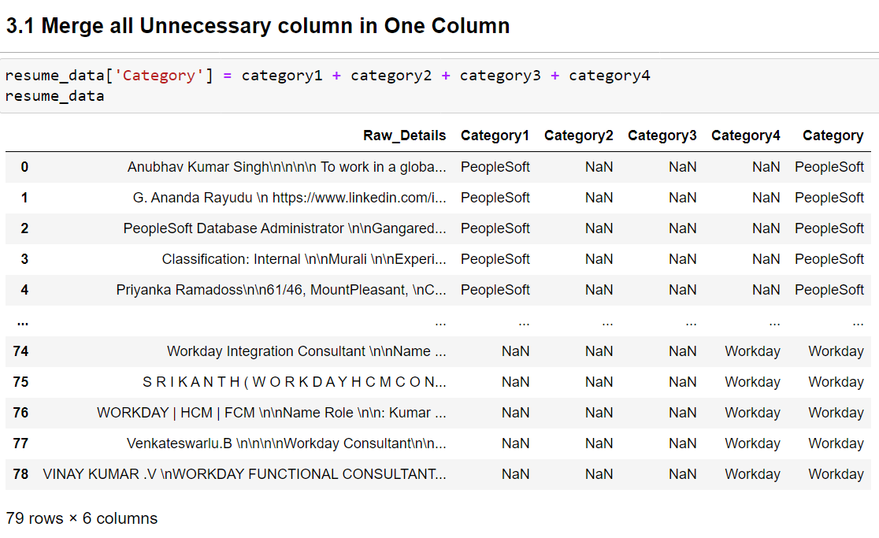

Slide 11
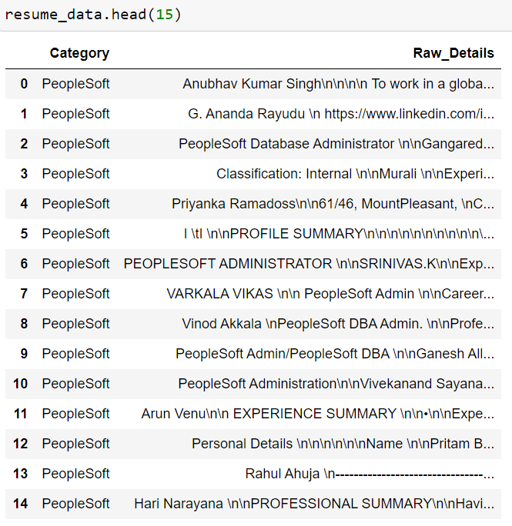
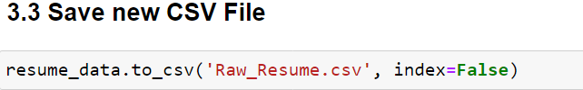
Final Dataset

Slide 12
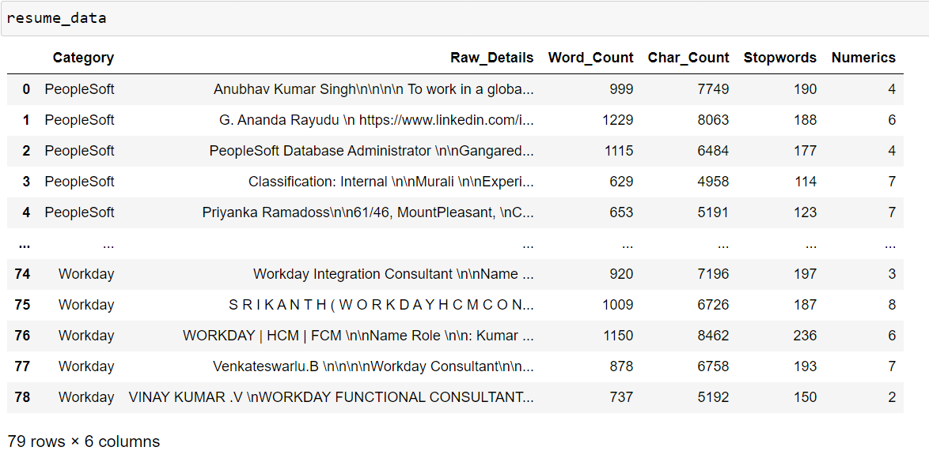

Slide 13
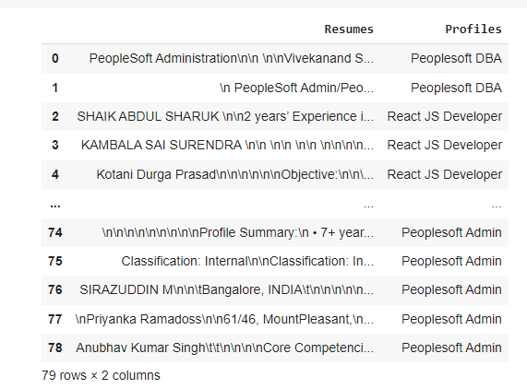
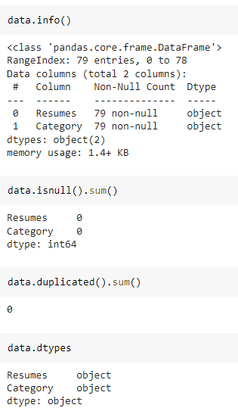
Dataset Details
After Extracting and Modifying the Dataset, given data contains a total of 4 Classes and 79 rows .

Slide 14
II . Exploratory Data Analysis (EDA)

Slide 15
Removing All Unwanted Character’s
Unwanted Character’s like - \n \t, http links, tags, hashtags, html tags, converting to lower case, removing white spaces etc.
Word Tokenization - Tokenization is essentially splitting a phrase, sentence, paragraph, or an entire text document into smaller units, such as individual words or terms. Each of these smaller units are called tokens.
Removing Stop-words - A stop word is a commonly used word (such as “the”, “a”, “an”, “in”) that a search engine has been programmed to ignore, both when indexing entries for searching and when retrieving them as the result of a search query.
Remove Punctuation From Text
Remove URL'S from Text
Apply Tokenization on 100 Words

Slide 16
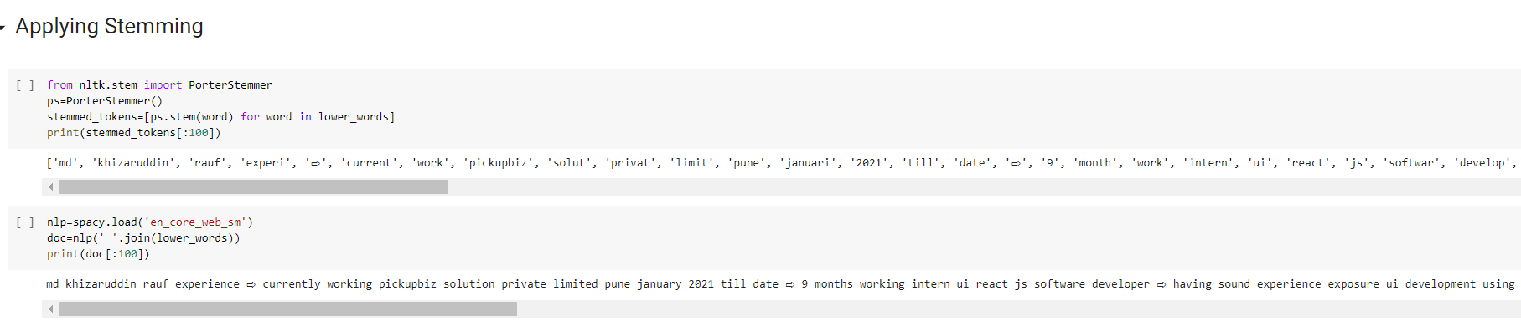
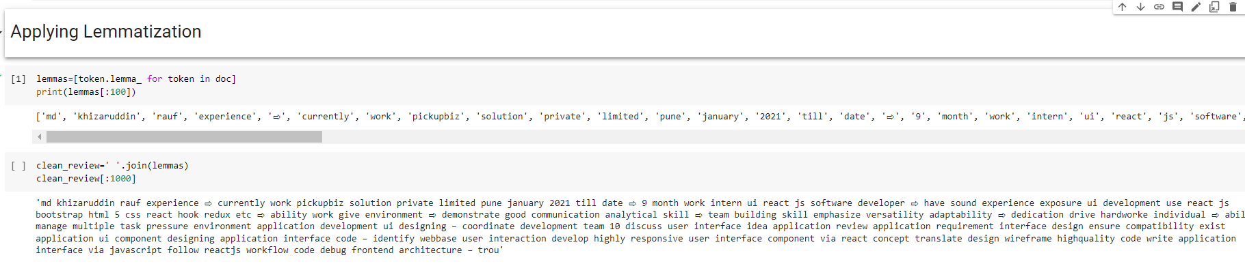
Text – Preprocessing
The Porter stemming algorithm (or 'Porter stemmer') is a process for removing the commoner morphological and inflectional endings from words in English.

Slide 17
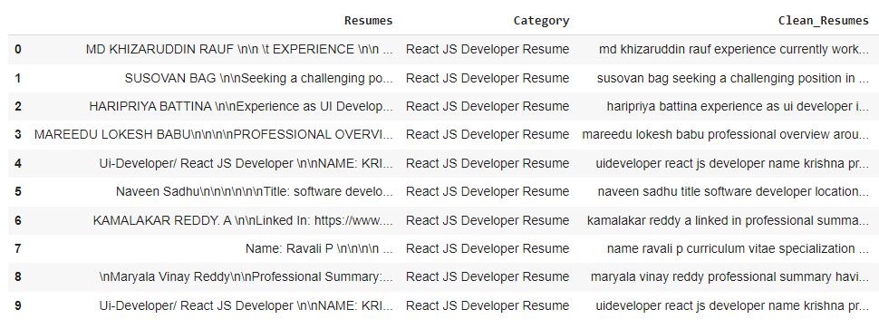
Text – Preprocessing
Before Text – Preprocessing After Text – Preprocessing
In natural language processing, text preprocessing is the practice of cleaning and preparing text data. NLTK and re are common Python libraries used to handle many text preprocessing tasks.
The Dataset contains 79 rows and 3 Column
There are total four Classes – Peoplesoft, Workday, React JS Developer and SQL Developer.

Slide 18
Data visualization

Slide 19
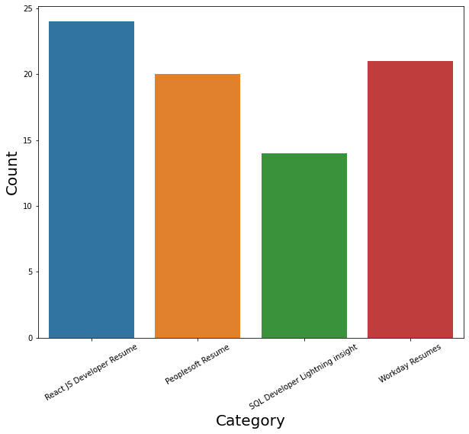
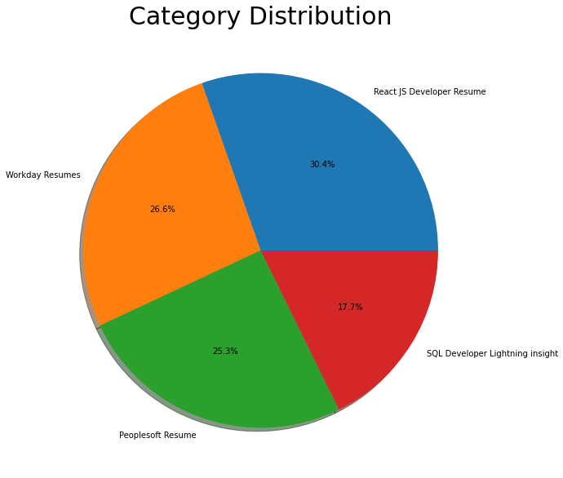
Labels
By using Histogram roles applied feature is displayed to check the job types.
By using Pie chart roles applied feature is displayed to visualize the job roles.

Slide 20
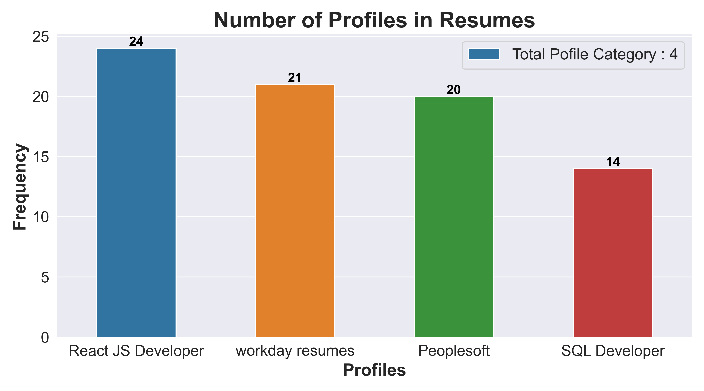
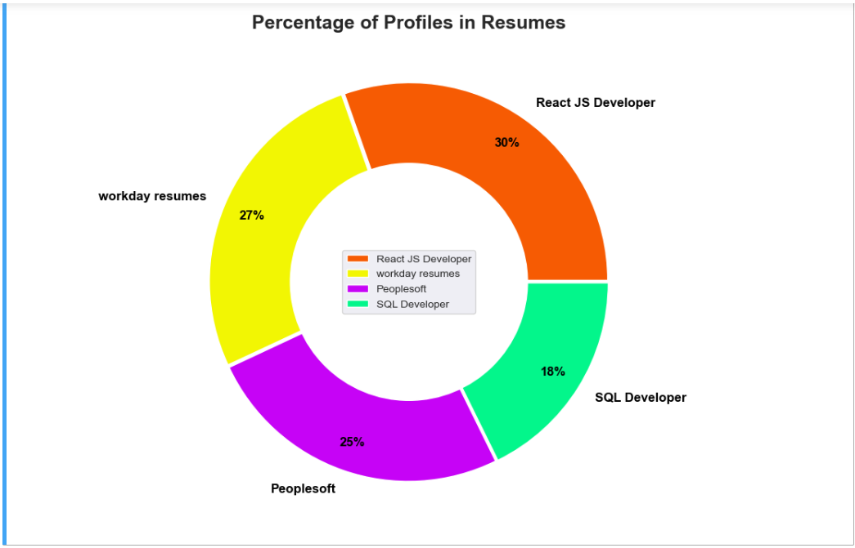
Number of Profiles in Resumes
Percentage of Profiles in Resumes

Slide 21
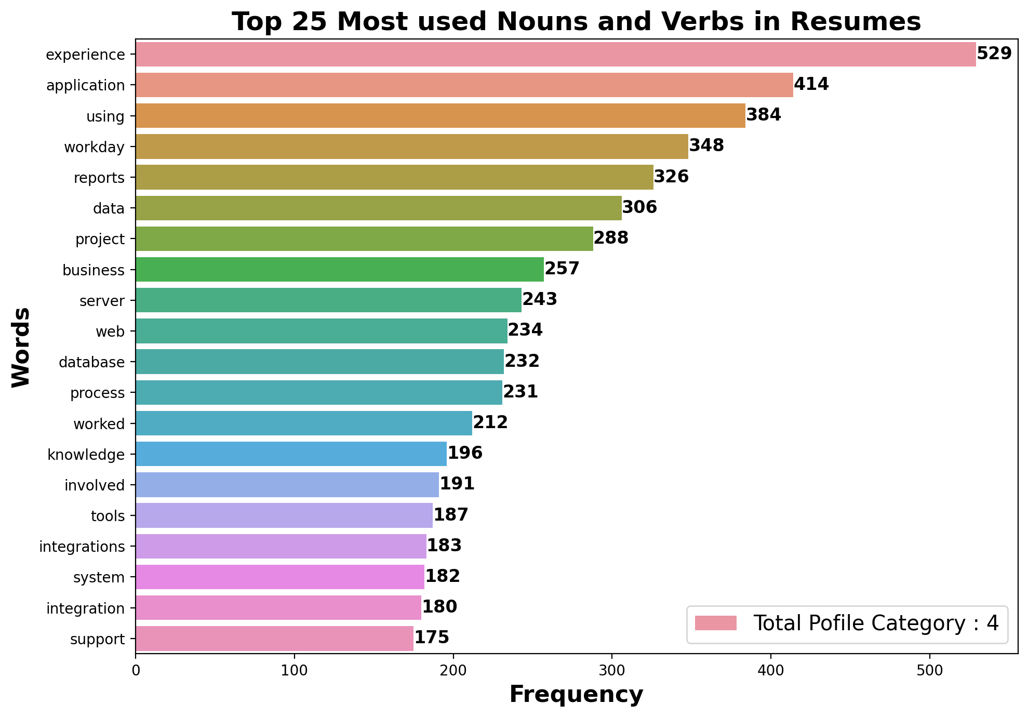
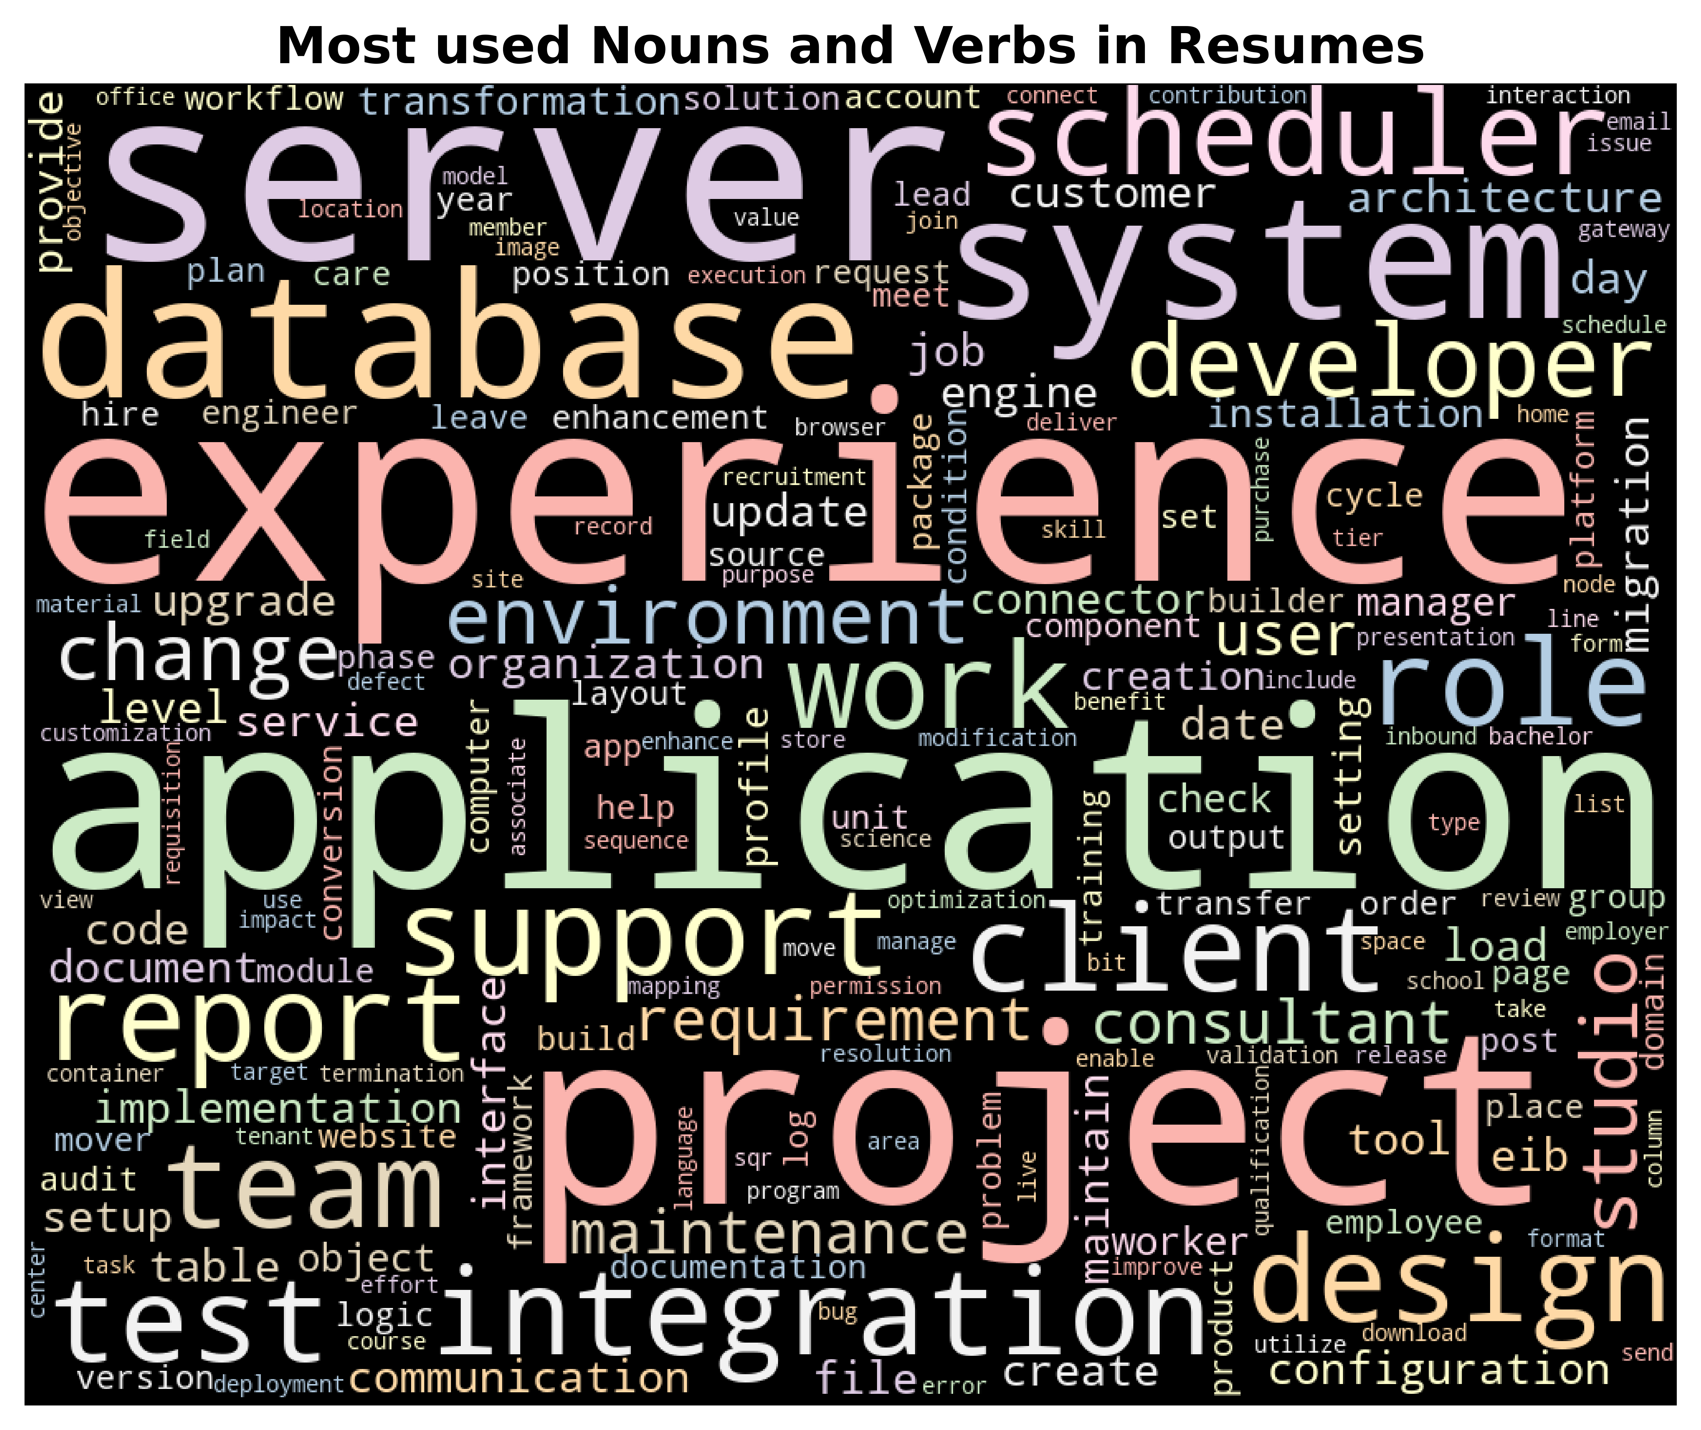

Slide 22
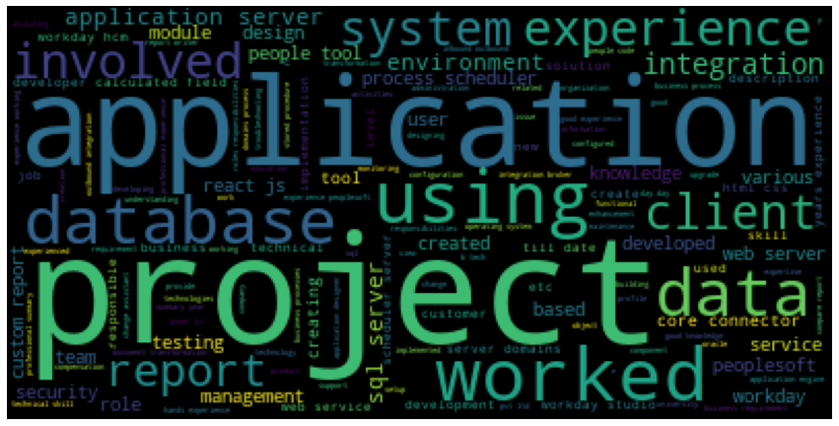
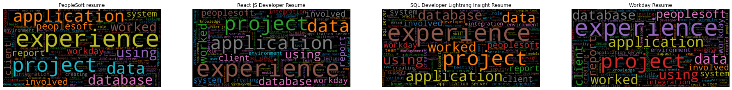
Word cloud

Slide 23
III - Model Building

Slide 24
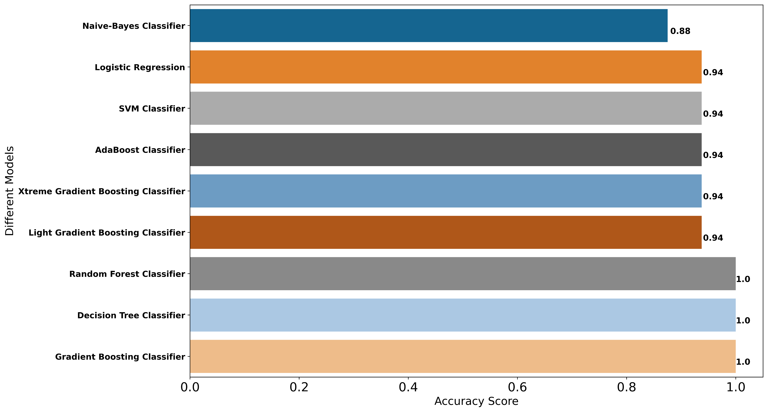
Model- Building
Accuracy on Testing Data

Slide 25
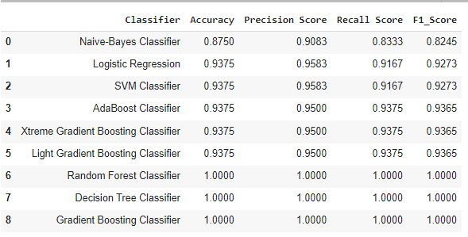
Model- Evaluation
Metrics on Testing Data
Here, we have taken Model building algorithms such as Decision Tree Classifier, Logistic Regression, SVM, Random , Forest, etc.
Among these algorithms, 100% Accuracy, Precision, Recall and F1-score have been achieved.
100% accuracy is achieved by using the model Random Forest, Decision Tree and Gradient Boosting Classifier.

Slide 26
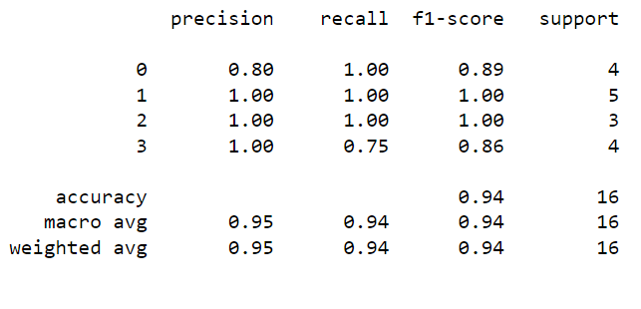
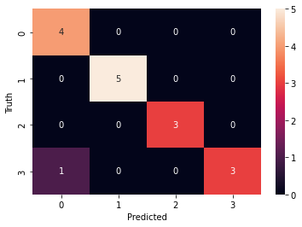
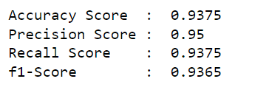
Model-Evaluation Report
XGBoost Classifier
Here, we have taken XGBoost Model.
.

Slide 27
IV - Model Deployment

Slide 28
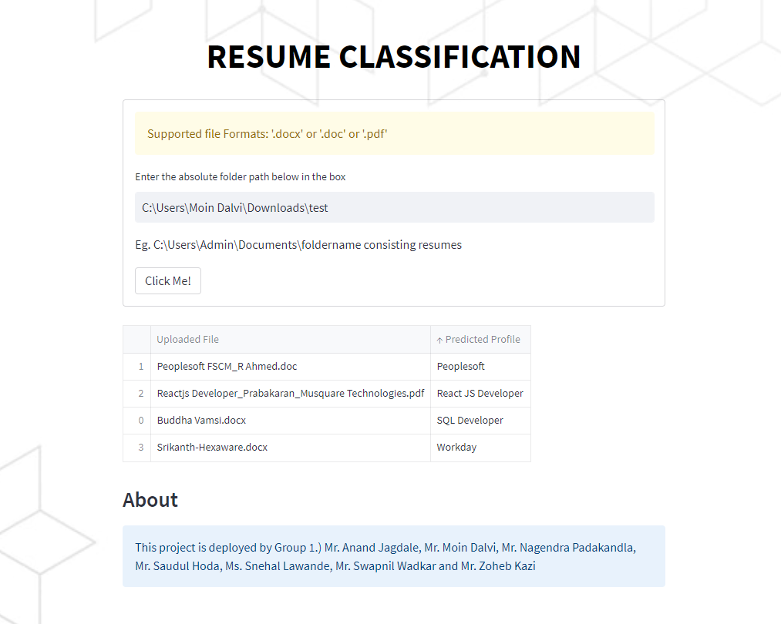
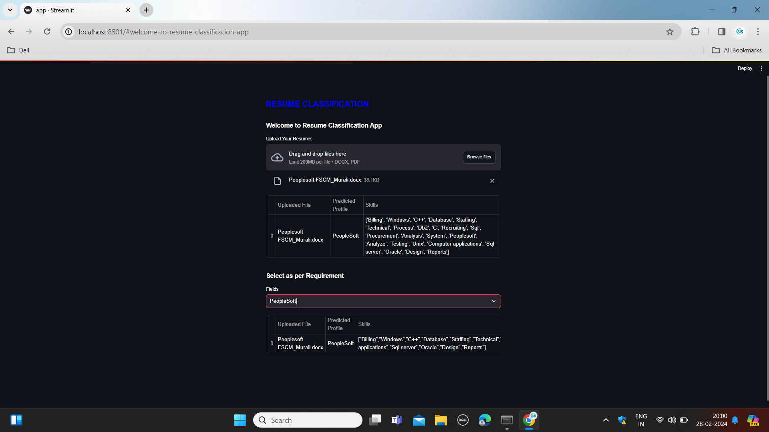
Deployment
Here, we have taken XG Boosting classifier as our Final Model algorithms for the deployment.
The algorithm has achieved 100% Accuracy, Precision, Recall and F1-score on testing data.
100% accuracy is achieved by using the model XG Boosting classifier no misclassification on validation set.
We have deployed the Resume Classification using Stream-lit as the platform

Slide 29
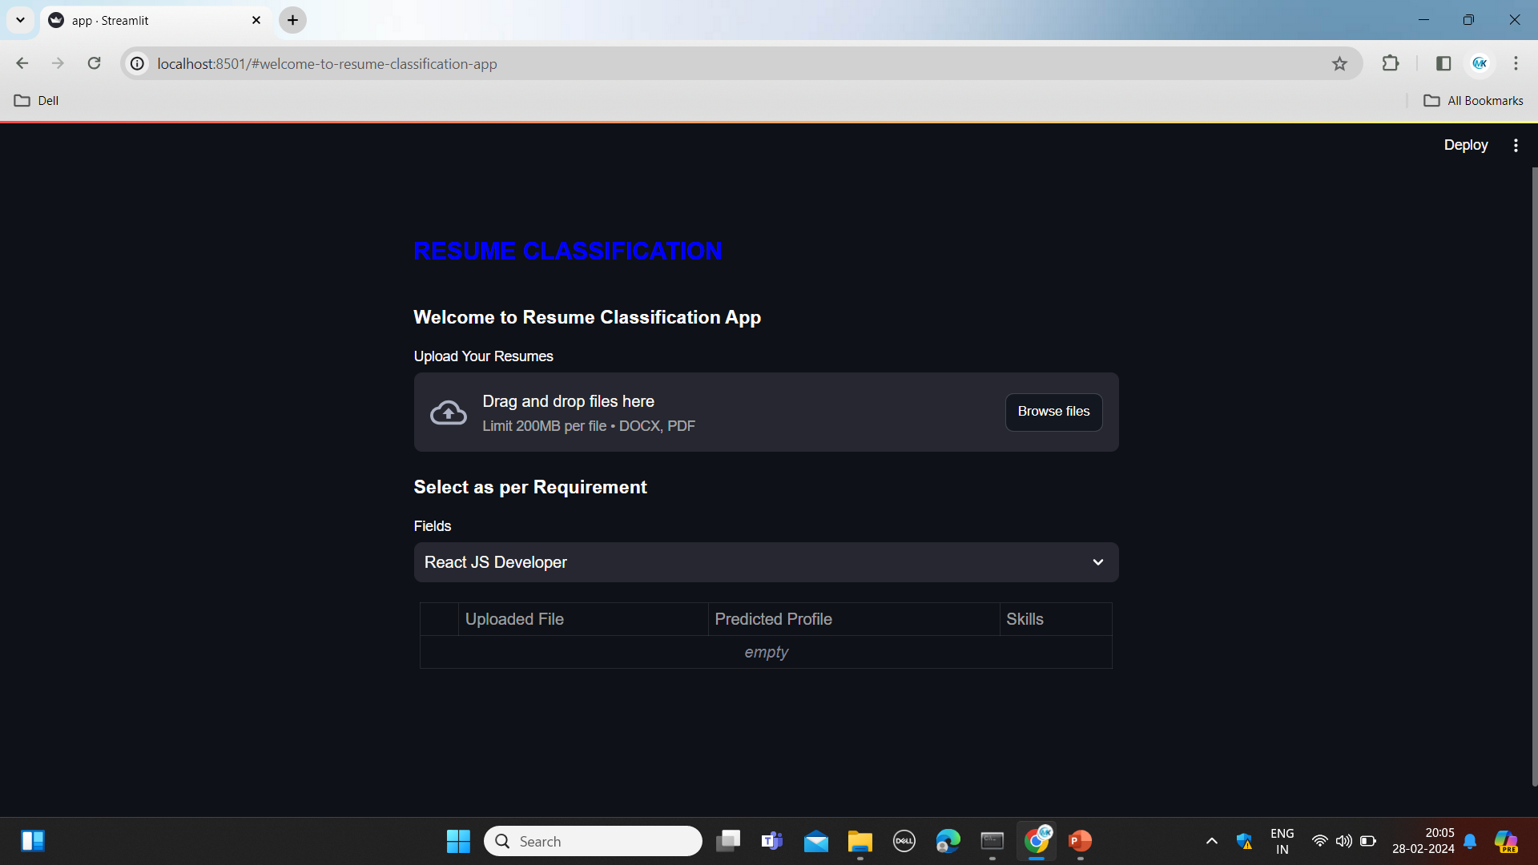
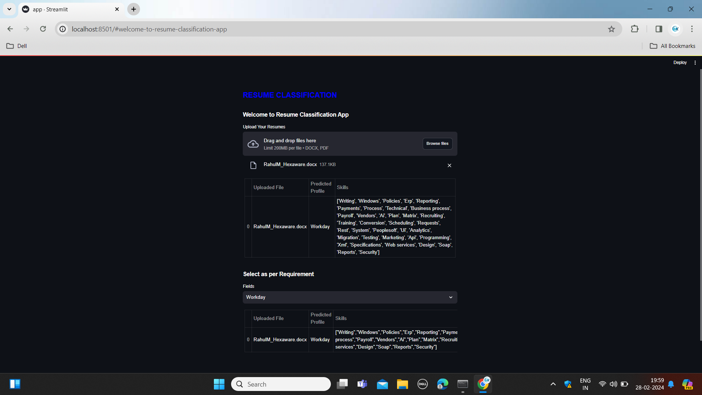
Example

Slide 30
V : Conclusion
Concluding the analysis, the XG Boost classifier emerged as the most effective model for document classification, demonstrating superior accuracy and precision. This advancement in machine learning models enhances HRM automation, paving the way for further optimizations.

Slide 31
Thank you!!!

